Slide 1
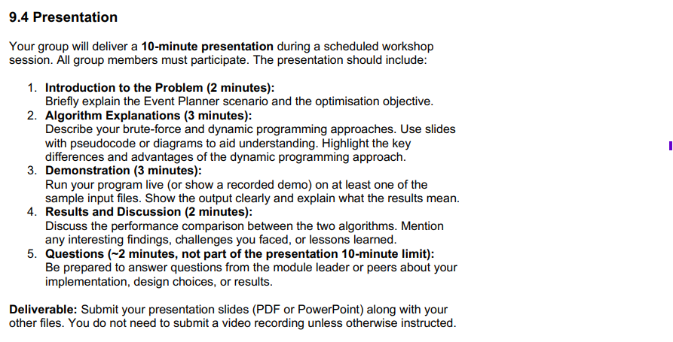
Howard
Henry and Theo
Boran
Steve
oe if you wanna change

Slide 2
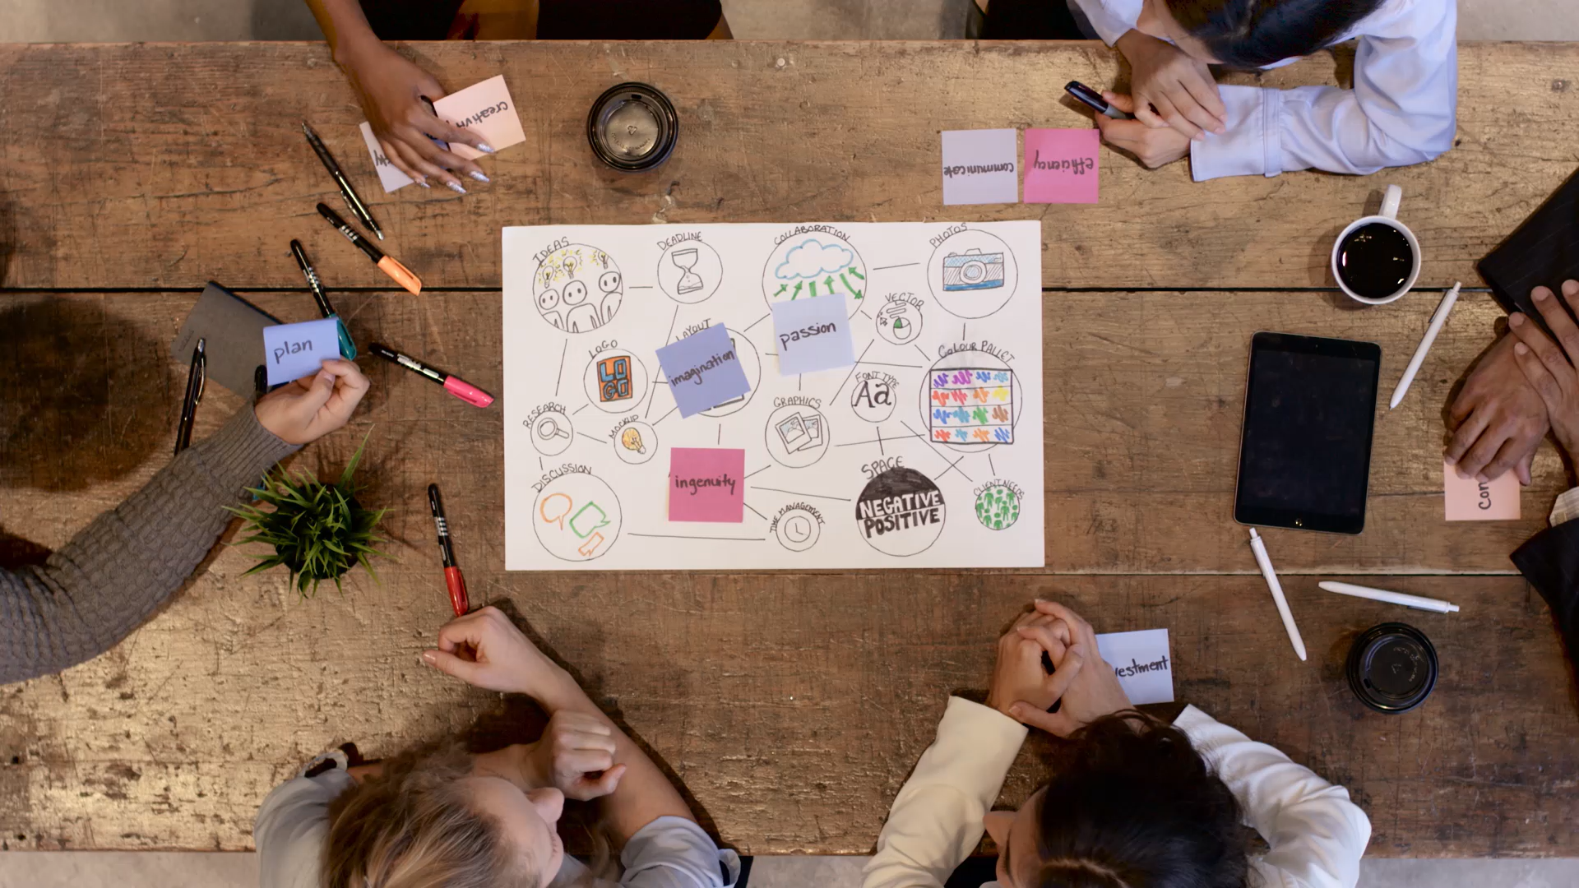
Society Event Planner
Howard Alix, Henry Beedham, Stephen Dorey, Boran Emin, Theo Swan

Slide 3

Introduction to the problem

Slide 4

Demonstration

Slide 5

Results and Dicussion

Slide 6

Questions

